Slide 1

INSTITUTE UIE
DEPARTMENT ACADEMIC UNIT-1
Bachelor of Engineering (Computer Science & Engineering)
Subject Name: Semiconductor Physics
Subject Code: 23SPH-143
Prepared By
Dr. Harjeevan Singh
P-N Junction, Solar cell and Characteristics
DISCOVER . LEARN . EMPOWER

Slide 2
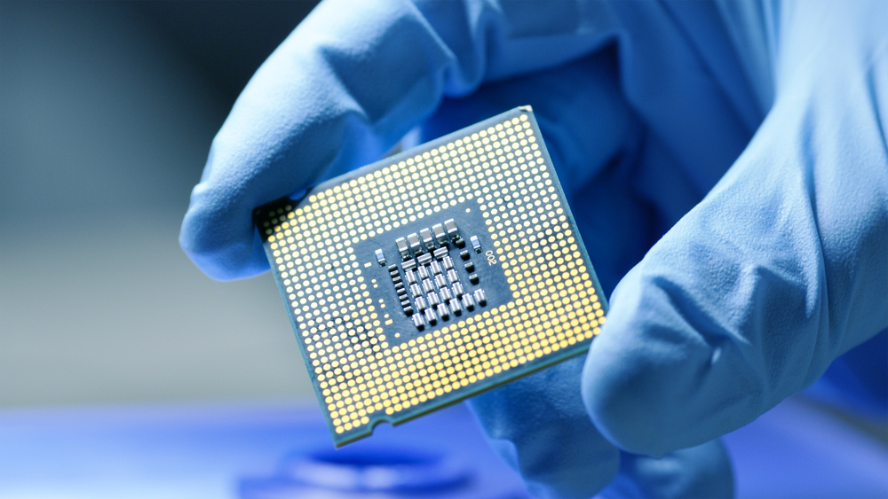
Course Objectives
S. No. | Objectives
1 | To understand the basic materials and properties of semiconductors.
2 | Understand the basic of semiconductor and components like diode, transistor, FET, MOSFET and Energy Sources.
3 | To give knowledge about semiconductor physics and discus working and applications of basic devices, including p-n junctions, BJTs and FETs.
https://www.iqsdirectory.com/resources/everything-you-ever-wanted-to-know-about-semiconductors/

Slide 3
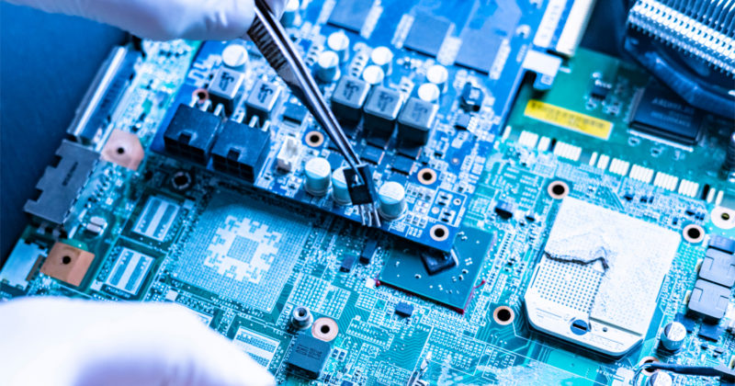
Course Outcomes
S.NO | Description | Blooms’ Taxonomy Level
CO1 | To apply the knowledge of basic semiconductor material physics and understand fabrication processes. | EASY
CO2 | To understand the characteristics of different electronic devices such as diodes, transistors. | MEDIUM
CO3 | To derive the relationships between the parameters in diode, FET, configurations of Transistor and MOSFETs. | MEDIUM
CO4 | To describe the working and design considerations for the various photonic devices like photo detectors, solar-cells and LEDs. | HARD
CO5 | To provide problem solving experience and learning of concepts through it in semiconductor physics. | HARD
https://lot.dhl.com/5-things-the-current-semiconductor-slowdown-tells-us-about-the-global-economy/

Slide 4
Content
Semiconductor and types
P-N Junction
Biasing of p-n junction
Characteristics of p-n junction.
Solar cell.
Construction of solar cell.
Working of solar cell.
Characteristics of solar cell
Applications of solar cells

Slide 5
Semiconductors
A semiconductor is a material which has an electrical conductivity value falling between that of a conductor, such as copper, and an insulator, such as glass.
Semiconductors are classified as intrinsic semiconductors and extrinsic semiconductors. Extrinsic semiconductors are further classified as N-type and P-type semiconductors.

Slide 6
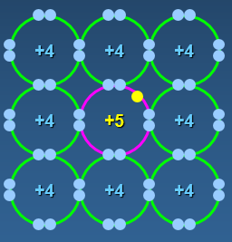
N-Type Material
When extra valence electrons are introduced into a material such as silicon an n-type material is produced. The extra valence electrons are introduced by putting impurities or dopant into the silicon. The dopant used to create an n-type material are Group V elements. The most commonly used dopant from Group V are arsenic, antimony and phosphorus.
Fig. 1: N-Type material

Slide 7
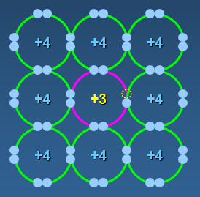
P-Type Material
P-type material is produced when the dopant that is introduced is from Group III. Group III elements have only 3 valence electrons and therefore there is an electron missing. This creates a hole (h+), or a positive charge that can move around in the material. Commonly used Group III dopant are aluminum, boron, and gallium.
Fig. 2: P-Type material

Slide 8
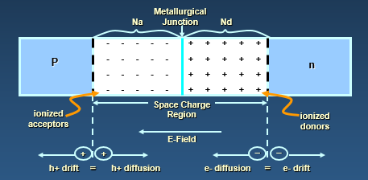
P-N Junction
A P-N junction is an interface or a boundary between two semiconductor material types, namely the p-type and the n-type, inside a semiconductor.
In a semiconductor, the P-N junction is created by the method of doping. The p-side or the positive side of the semiconductor has an excess of holes, and the n-side or the negative side has an excess of electrons. The process of doping is explained in further detail in the next section.
When no external source is connected to the pn junction, diffusion and drift balance each other out for both the holes and electrons
Fig. 3: P-N Junction

Slide 9
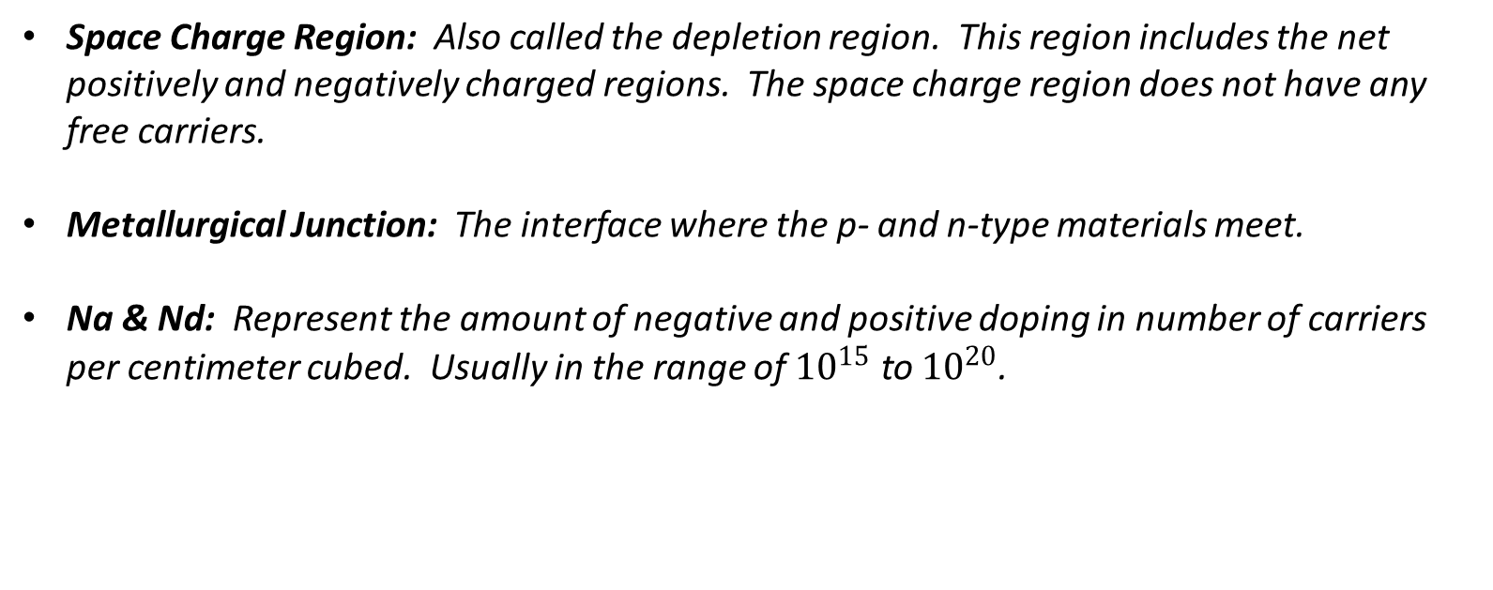
P-N Junction
Space Charge Region: Also called the depletion region. This region includes the net positively and negatively charged regions. The space charge region does not have any free carriers.
Metallurgical Junction: The interface where the p- and n-type materials meet.
Na & Nd: Represent the amount of negative and positive doping in number of carriers per centimeter cubed. Usually in the range of ${10}^{15}$ to ${10}^{20}$.

Slide 10
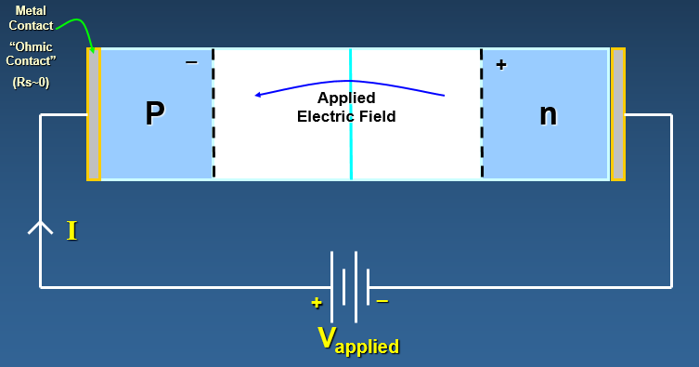
Biased P-N Junction
Fig. 4: Biased P-N Junction
The pn junction is considered biased when an external voltage is applied. There are two types of biasing: Forward bias and Reverse bias.

Slide 11
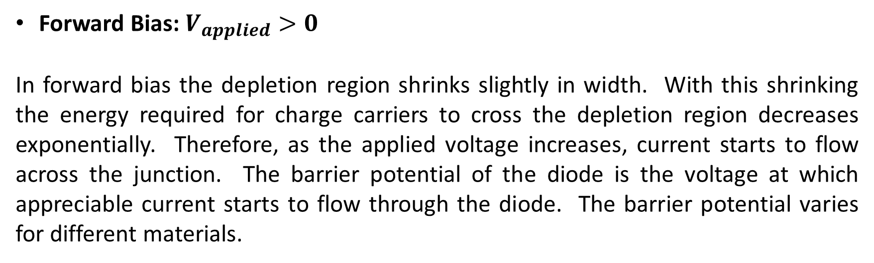
Biased P-N Junction
Forward Bias: $V_{applied}>0$
In forward bias the depletion region shrinks slightly in width. With this shrinking the energy required for charge carriers to cross the depletion region decreases exponentially. Therefore, as the applied voltage increases, current starts to flow across the junction. The barrier potential of the diode is the voltage at which appreciable current starts to flow through the diode. The barrier potential varies for different materials.

Slide 12
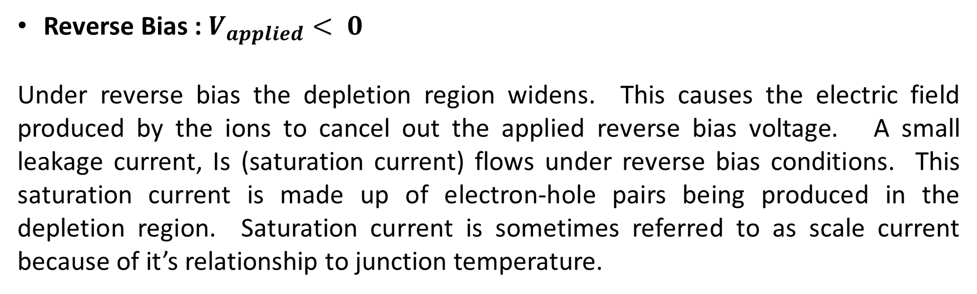
Biased P-N Junction
Reverse Bias : $V_{applied}< 0$
Under reverse bias the depletion region widens. This causes the electric field produced by the ions to cancel out the applied reverse bias voltage. A small leakage current, Is (saturation current) flows under reverse bias conditions. This saturation current is made up of electron-hole pairs being produced in the depletion region. Saturation current is sometimes referred to as scale current because of it’s relationship to junction temperature.

Slide 13
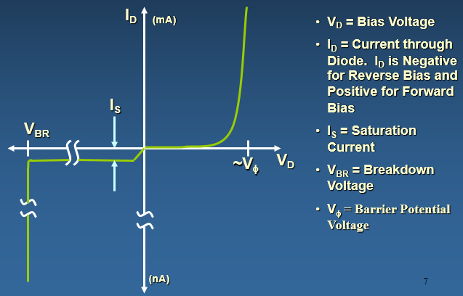
Diode Properties
Fig. 5: V-I Characteristic curve

Slide 14
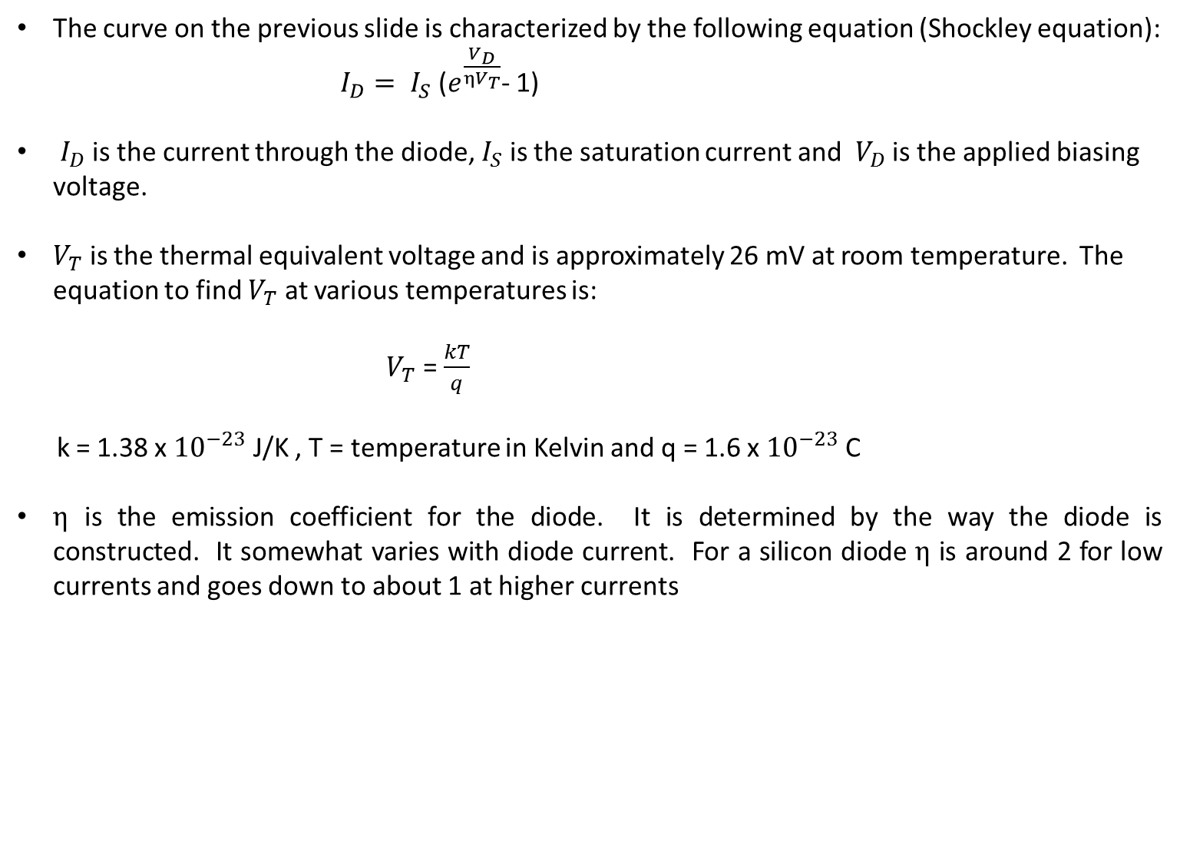
Diode Properties
The curve on the previous slide is characterized by the following equation (Shockley equation):
$I_{D}= I_{S}$ ($e^{\frac{V_{D}}{ηV_{T}}}$- 1)
$I_{D}$ is the current through the diode, $I_{S}$ is the saturation current and $V_{D}$ is the applied biasing voltage.
$V_{T}$ is the thermal equivalent voltage and is approximately 26 mV at room temperature. The equation to find $V_{T}$ at various temperatures is:
$V_{T}$ = $\frac{kT}{q}$
k = 1.38 x ${10}^{−23}$ J/K , T = temperature in Kelvin and q = 1.6 x ${10}^{−23}$ C
$η$ is the emission coefficient for the diode. It is determined by the way the diode is constructed. It somewhat varies with diode current. For a silicon diode $η$ is around 2 for low currents and goes down to about 1 at higher currents

Slide 15
Solar Cell
A solar cell (also known as a photovoltaic cell or PV cell) is defined as an electrical device that converts light energy into electrical energy through the photovoltaic effect. A solar cell is basically a p-n junction diode. Solar cells are a form of photoelectric cell, defined as a device whose electrical characteristics – such as current, voltage, or resistance – vary when exposed to light.
Individual solar cells can be combined to form modules commonly known as solar panels. The common single junction silicon solar cell can produce a maximum open-circuit voltage of approximately 0.5 to 0.6 volts. By itself this isn’t much – but remember these solar cells are tiny. When combined into a large solar panel, considerable amounts of renewable energy can be generated.

Slide 16
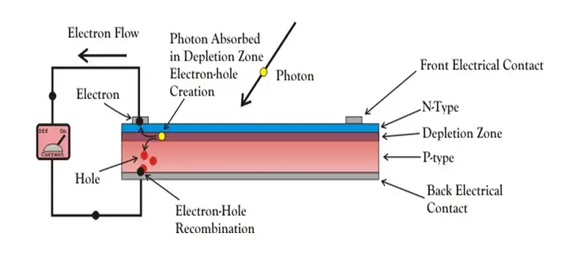
Solar Cell
Fig. 6: Solar cell

Slide 17
Construction of Solar Cell
A solar cell is basically a junction diode, although its construction it is little bit different from conventional p-n junction diodes. A very thin layer of p-type semiconductor is grown on a relatively thicker n-type semiconductor. We then apply a few finer electrodes on the top of the p-type semiconductor layer.
These electrodes do not obstruct light to reach the thin p-type layer. Just below the p-type layer there is a p-n junction. We also provide a current collecting electrode at the bottom of the n-type layer. We encapsulate the entire assembly by thin glass to protect the solar cell from any mechanical shock

Slide 18
Working of Solar Cell
When light reaches the p-n junction, the light photons can easily enter in the junction, through very thin p-type layer. The light energy, in the form of photons, supplies sufficient energy to the junction to create a number of electron-hole pairs. The incident light breaks the thermal equilibrium condition of the junction. The free electrons in the depletion region can quickly come to the n-type side of the junction.
Similarly, the holes in the depletion can quickly come to the p-type side of the junction. Once, the newly created free electrons come to the n-type side, cannot further cross the junction because of barrier potential of the junction.

Slide 19
Working of Solar Cell
Similarly, the newly created holes once come to the p-type side cannot further cross the junction became of same barrier potential of the junction. As the concentration of electrons becomes higher in one side, i.e. n-type side of the junction and concentration of holes becomes more in another side, i.e. the p-type side of the junction, the p-n junction will behave like a small battery cell. A voltage is set up which is known as photo voltage. If we connect a small load across the junction, there will be a tiny current flowing through it.

Slide 20
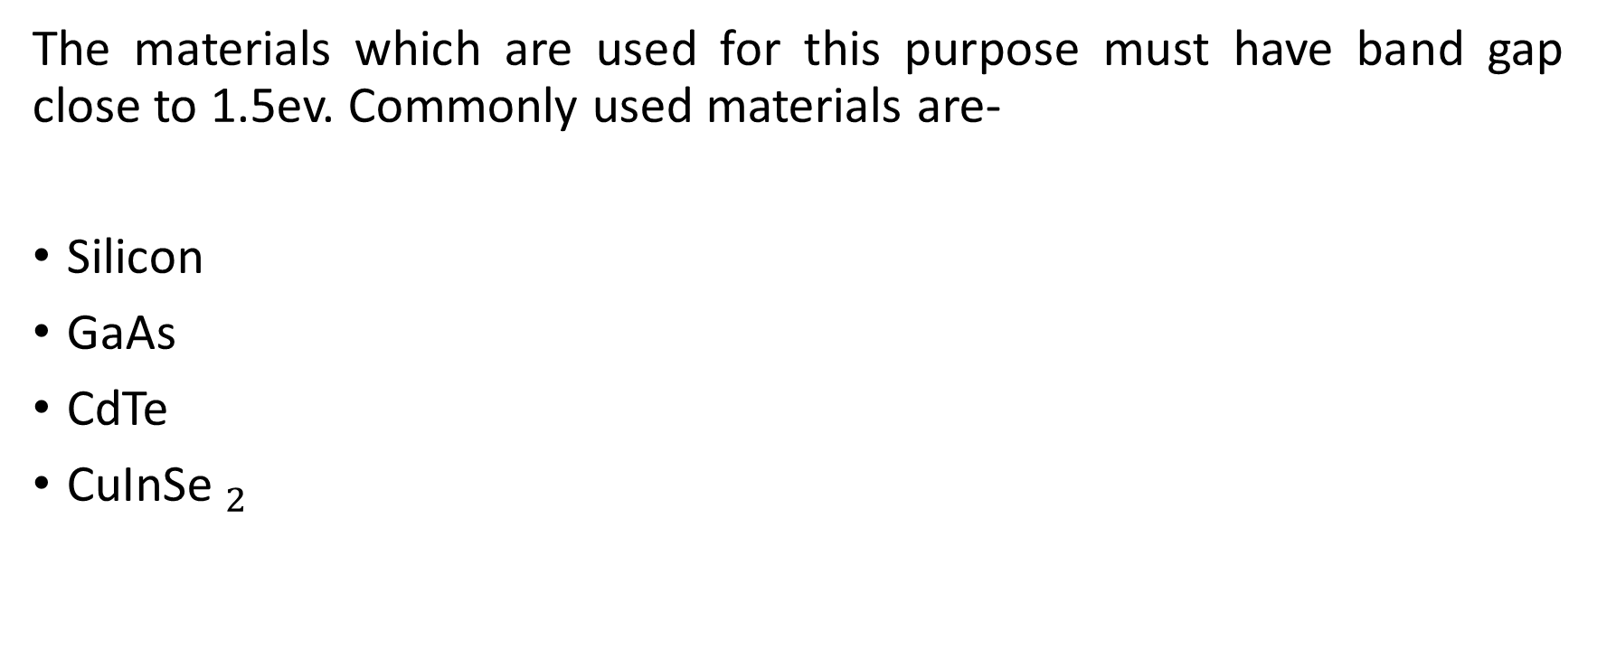
Materials Used in Solar Cell
The materials which are used for this purpose must have band gap close to 1.5ev. Commonly used materials are-
Silicon
GaAs
CdTe
${\text{CuInSe} }_{2}$

Slide 21
Criteria for Materials to be Used in Solar Cell
Must have band gap from 1ev to 1.8ev.
It must have high optical absorption.
It must have high electrical conductivity.
The raw material must be available in abundance and the cost of the material must be low.

Slide 22
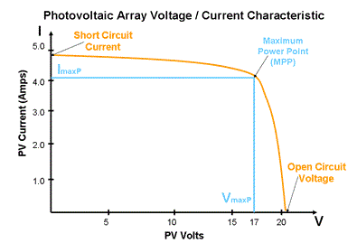
V-I Characteristics
Fig. 6: V-I characteristics of solar cell

Slide 23
Applications of solar cells
It is used in calculators and in wrist watches
Used in storage batteries
Street lights
Portable power supplies
Satellite
Transportation
Solar cell panels

Slide 24
Summary
Introduction to semiconductors.
Various types of semiconductors.
Basics of diode and its biasing.
Introduction to Solar cell.
Construction and working of solar cell.
Applications of solar cells

Slide 25
Frequently Asked Questions
What is the difference between N-Type and p-Type materials?
Give the difference between forward bias and reverse bias.
What do you mean by breakdown voltage?
Explain working of solar cells.
What are the applications of solar cells?

Slide 26
Practice Questions
Elaborate the practical applications of diode in real life scenarios.
Study the datasheet and design characteristics of a typical solar panel, used for powering a house or a building.

Slide 27

LEARNING OUTCOMES
To make students understand
Concepts of semicnonductors
Basics of diode cicuits.
Fundamentals of solar cells and their applications.

Slide 28
Assessment Pattern
A Assignment (each assignment) | B Time Bound Surprise Test (each test) | C Quiz (each quiz) | D Mid Semester Test(one per test) | E Homework | F Discussion Forums | G Attendance and engagement Score on BB
10 | 12 | 4 | 20 | NA | NA | 2

Slide 29
References
Textbooks of Basic Electrical & Electronics Engineering:
Fundamentals of Electrical Circuits by Charles k.
Electrical Technology by Surinder Pal Bali, Pearson Publications.
Video Links:
https://www.youtube.com/watch?v=L28F1Oenyds
https://www.youtube.com/watch?v=mCgXsEyQZSI
https://www.youtube.com/watch?v=ZYO83TkM0To

Slide 30
References
Website Links:
https://www.electrical4u.com/solar-cell/
https://energyeducation.ca/encyclopedia/Diode_operation
https://ecstudiosystems.com/discover/textbooks/solid-state-devices/semiconductor-diodes/pn-junction-operation/
https://www.tutorialspoint.com/semiconductor_devices/semiconductor_devices_diode_characteristics.htm

Slide 31
THANK YOU
For queries
Email:

